Slide 1
Intro.
Digital Design and Computer Architecture
David Money Harris and Sarah L. Harris
Lectured by Jeong-Gun Lee @ Hallym
Copyright © 2007 Elsevier
1-<<number>>

Slide 2
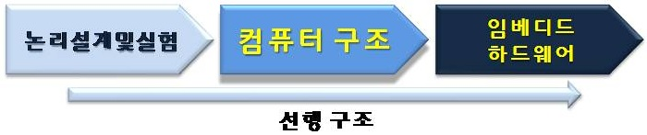
Logic Design and Lab
Copyright © 2007 Elsevier
6-<<number>>

Slide 3
Staff
Instructor: Jeong-Gun Lee
  www.onchip.net
  Jeonggun.lee@gmail.com / jeonggun.lee@hallym.ac.kr
  1306 Sungho Build.
Teaching Assistance
  Young-Joon Yoo
  Operating System Lab.
Copyright © 2007 Elsevier
6-<<number>>

Slide 4
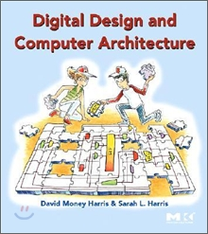
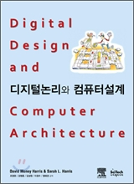
Text
http://www.yes24.com/24/goods/2408401
http://www.yes24.com/24/goods/3311366
Copyright © 2007 Elsevier
6-<<number>>

Slide 5
Evaluation
Exam
  Midterm: 30%
  Final term: 40%
Lab: 30%
If you miss class lectures more than 4, you will get “F”
Copyright © 2007 Elsevier
6-<<number>>

Slide 6
Chapter 1 :: From Zero to One
“영”에서 “일”까지…
Digital Design and Computer Architecture
David Money Harris and Sarah L. Harris
Lectured by Jeong-Gun Lee @ Hallym
Copyright © 2007 Elsevier
1-<<number>>

Slide 7
Chapter 1 :: Topics
Background (배경)
The Game Plan (계획)
The Digital Abstraction (디지털 추상화)
Number Systems (수 표현 체계)
Logic Gates (논리 회로/논리 게이트)
CMOS Transistors (CMOS 트랜지스터)
Power Consumption (전력 소모)
Copyright © 2007 Elsevier
1-<<number>>

Slide 8
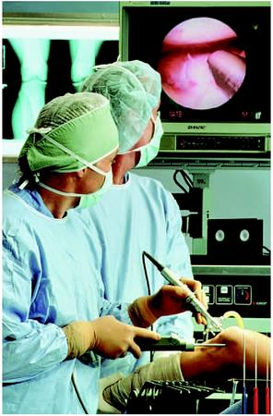
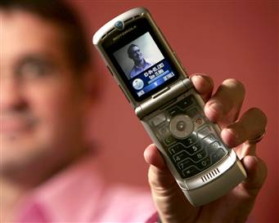
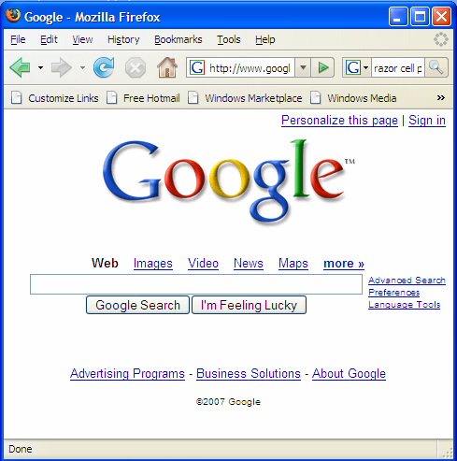
Background (배경)
Microprocessors have revolutionized our world
  Cell phones, Internet, rapid advances in medicine, etc.
The semiconductor industry has grown from $21 billion (10억) in 1985 to $213 billion in 2004
Copyright © 2007 Elsevier
1-<<number>>

Slide 9

The Game Plan (계획? / 수업의 목적)
The purpose of this course is that you:
  Learn what’s under the hood of a computer
  컴퓨터 내부에 대해서 배운다!
  Learn the principles of digital design
  디지털 설계에 대한 원칙에 대해서 배운다!
  Design and build a microprocessor
  마이크로프로세서를 설계 및 구축한다!
Copyright © 2007 Elsevier
1-<<number>>

Slide 10
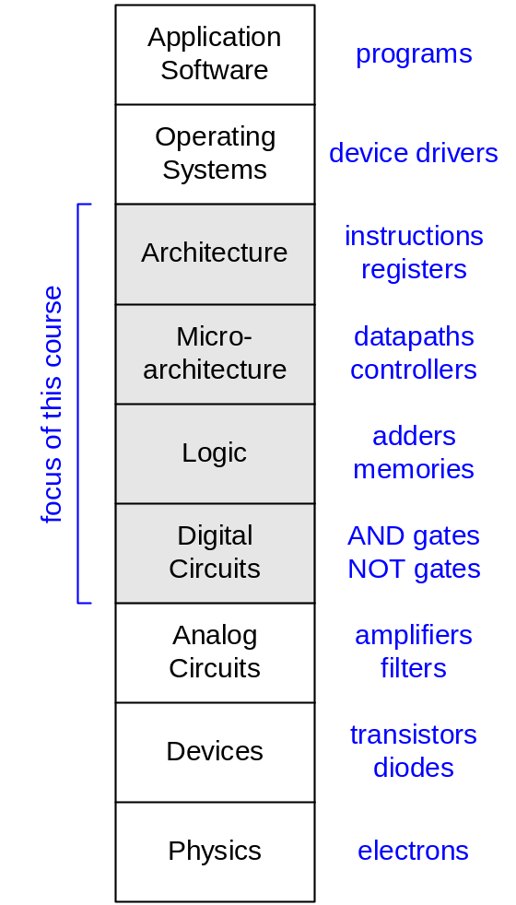

Abstraction
Hiding details when they aren’t important
컴퓨터 구조
논리설계 및 실습
Copyright © 2007 Elsevier
6-<<number>>

Slide 11
The Digital Abstraction
Most physical variables are continuous, for example
  Voltage on a wire (와이어 상의 전압)
  Frequency of an oscillation (발진의 주파수)
  Position of a mass (질량의 위치)
Instead of considering all values, the digital abstraction considers only a discrete subset of values
Copyright © 2007 Elsevier
1-<<number>>

Slide 12

Digital Discipline: Binary (이진!)
Typically consider only two discrete values:
(두개의 이진 값만을 고려하자!!!)
  1’s and 0’s (1과 0)
  1, TRUE, HIGH (1 == 사실 == 높은 값)
  0, FALSE, LOW (0 == 거짓 == 낮은 값)
Digital circuits usually depend on specific voltage levels to represent 1 and 0
  (디지털회로는 일반적으로 1과 0을 표현하기 위해서 특정 전압을 사용한다)
Bit: Binary (이진) digit (수)
Copyright © 2007 Elsevier
1-<<number>>

Slide 13
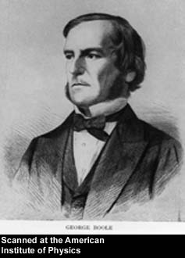
George Boole, 1815 - 1864
Born to working class parents
Taught himself mathematics and joined the faculty of Queen’s College in Ireland.
Wrote An Investigation of the Laws of Thought (1854)
Introduced binary variables
Introduced the three fundamental logic operations: AND, OR, and NOT.
Copyright © 2007 Elsevier
1-<<number>>

Slide 14
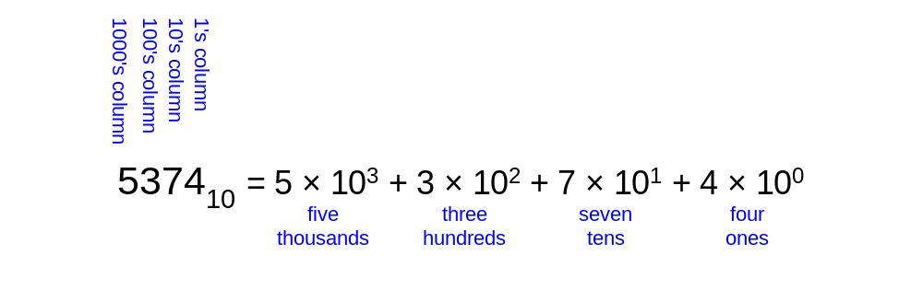
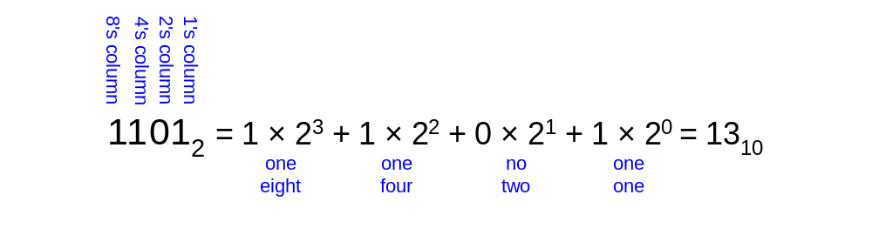
Number Systems (수의 체계)
Decimal numbers (십진수)
Binary numbers (이진수)
Copyright © 2007 Elsevier
1-<<number>>

Slide 15
Number Conversion (수의 변환)
Decimal to binary conversion:
  Convert 10101₂ to decimal
Decimal to binary conversion:
  Convert 47₁₀ to binary
Copyright © 2007 Elsevier
1-<<number>>

Slide 16
Binary Values (이진값) and Range (범위)
Consider an N-digit decimal number
  Represents (표현하다) 10^{N} possible values
  Range (범위) is: [0, 10^{N} - 1]
  For example, a 3-digit decimal number represents 10³ = 1000 possible values, with a range of [0, 999]
Consider an N-bit binary number
  Represents 2^{N} possible values
  Range is: [0, 2^{N} - 1]
  For example, a 3-digit binary number represents 2³ = 8 possible values, with a range of [0, 7] (i.e., 000₂ to 111₂)
Copyright © 2007 Elsevier
1-<<number>>

Slide 17
Hexadecimal Numbers (16진수)
Hex Digit | Decimal Equivalent | Binary Equivalent
0 | 0 | 0000
1 | 1 | 0001
2 | 2 | 0010
3 | 3 | 0011
4 | 4 | 0100
5 | 5 | 0101
6 | 6 | 0110
7 | 7 | 0111
8 | 8 | 1000
9 | 9 | 1001
A | 10 | 1010
B | 11 | 1011
C | 12 | 1100
D | 13 | 1101
E | 14 | 1110
F | 15 | 1111
Copyright © 2007 Elsevier
1-<<number>>

Slide 18
Hexadecimal Numbers
Base 16
Shorthand (짧은표현) for Binary
Copyright © 2007 Elsevier
1-<<number>>

Slide 19
Hexadecimal to Binary Conversion
Hexadecimal to binary conversion (변환):
  Convert 4AF₁₆ (also written 0x4AF) to binary
Hexadecimal to decimal conversion:
  Convert 0x4AF to decimal
Copyright © 2007 Elsevier
1-<<number>>

Slide 20
Hexadecimal to Binary Conversion
(16진수의 이진수 변환)
Hexadecimal to binary conversion:
  Convert 4AF₁₆ (also written 0x4AF) to binary
  010010101111₂
Hexadecimal to decimal conversion:
  Convert 0x4AF to decimal
  010010101111₂ = 1 + 2 + 4 + 8 + 32 + 128 + 1024
        = 1199₁₀
  0x4AF = (15 × 16⁰) + (10 × 16¹) + (4 × 16²)
  = 1199₁₀
Copyright © 2007 Elsevier
1-<<number>>

Slide 21
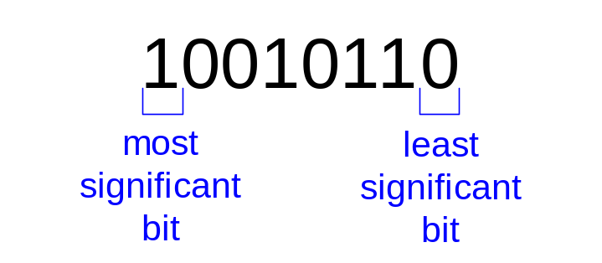
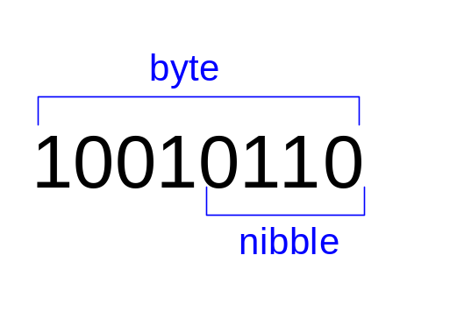
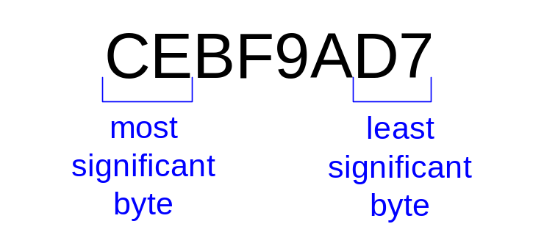
Bits, Bytes, Nibbles…
Bits
Bytes & Nibbles
Bytes
Copyright © 2007 Elsevier
1-<<number>>

Slide 22
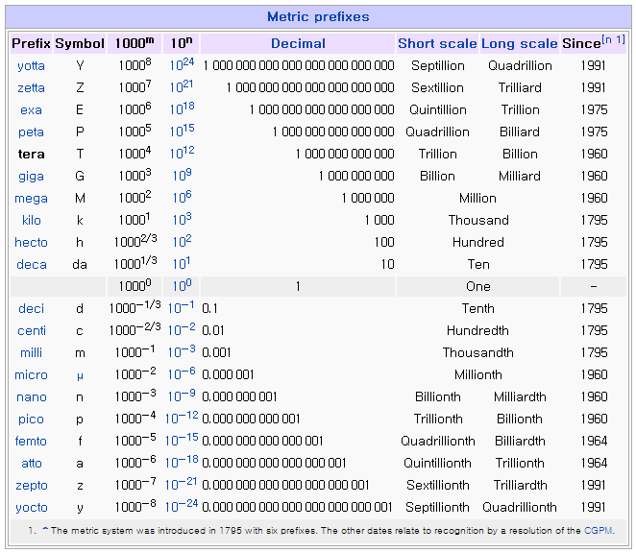
Powers of Two (2의 자승수)
2¹⁰ = 1 kilo ≈ 1000 (1024)
2²⁰ = 1 mega ≈ 1 million (1,048,576)
2³⁰ = 1 giga ≈ 1 billion (1,073,741,824)
Copyright © 2007 Elsevier
1-<<number>>

Slide 23
Estimating Powers of Two
What is the value of 2²²?
  2² × 2²⁰ = 4 Mega
How many values can a 32-bit variable represent?
  2² × 2³⁰ = 4 Giga
Copyright © 2007 Elsevier
1-<<number>>

Slide 24
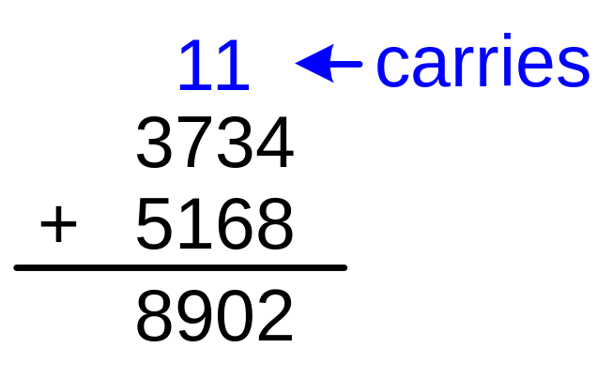

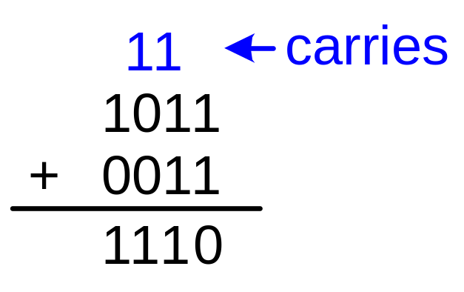
Addition (더하기)
Decimal
Binary
Copyright © 2007 Elsevier
1-<<number>>

Slide 25
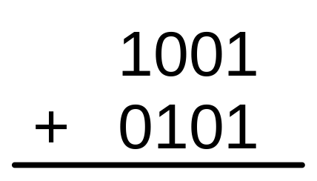
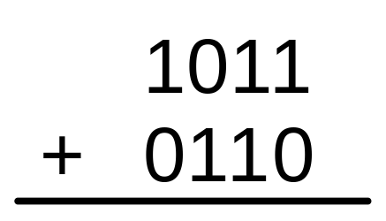
Binary Addition Examples
Add the following 4-bit binary numbers
(다음 4비트 이진수를 더하세요)
Add the following 4-bit binary numbers
Copyright © 2007 Elsevier
1-<<number>>

Slide 26
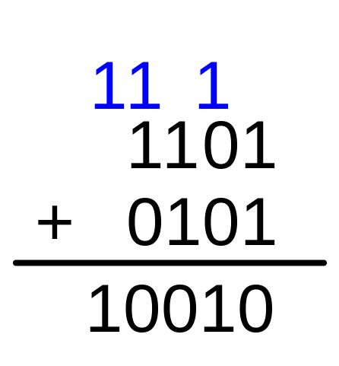
Overflow (오버플로우, 넘침)
Digital systems operate on a fixed number of bits
  디지털시스템은 특정 비트의 수만을 가지고 동작한다.
Addition overflows when the result is too big to fit in the available number of bits
Example: add 13 and 5 using 4-bit numbers
Copyright © 2007 Elsevier
1-<<number>>

Slide 27
Signed Binary Numbers
(부호를 가진 수의 표현)
Sign/Magnitude Numbers (부호/절대값)
Two’s Complement Numbers (2의 보수)
Copyright © 2007 Elsevier
1-<<number>>

Slide 28
Sign/Magnitude Numbers
1 sign bit, N-1 magnitude bits
Sign bit is the most significant (left-most) bit
Negative number: sign bit = 1
Positive number: sign bit = 0
Example, 4-bit representations of ± 5:
- 5 = 1101₂
+5 = 0101₂
Range of an N-bit sign/magnitude number:
[-(2^{N-1}-1), 2^{N-1}-1]
Copyright © 2007 Elsevier
1-<<number>>

Slide 29
Sign/Magnitude Numbers
Problems:
  Addition doesn’t work, for example -5 + 5:
1101
+ 0101
10010
  Two representations of 0 (± 0):
1000
0000
Copyright © 2007 Elsevier
1-<<number>>

Slide 30

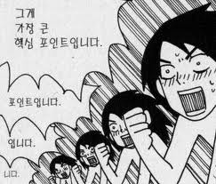
Two’s Complement Numbers
Don’t have same problems as sign/magnitude numbers:
  Addition works
  Single representation for 0
Copyright © 2007 Elsevier
1-<<number>>

Slide 31
Two’s Complement Numbers
Same as unsigned binary, but the most significant bit (msb) has value of -2^{N-1}
Most positive 4-bit number: 0111₂ (7₁₀)
Most negative 4-bit number: 1000₂ (-2³ = -8₁₀)
The most significant bit still indicates the sign (1 = negative, 0 = positive)
Range of an N-bit two’s complement number: [-2^{N-1}, 2^{N-1}-1]
Copyright © 2007 Elsevier
1-<<number>>

Slide 32
“Taking the Two’s Complement”
Reversing the sign of a two’s complement number (2의 보수 표현에서 음수화 작업)
Method:
    Invert the bits
    Add 1
Example: Reverse the sign of 0111₂
    1000
    + 1
    1001
Copyright © 2007 Elsevier
1-<<number>>

Slide 33
Two’s Complement Examples
Take the two’s complement of 0110₂
    1001
    + 1
    1010
Take the two’s complement of 1101₂
    0010
    + 1
    0011
Copyright © 2007 Elsevier
1-<<number>>

Slide 34
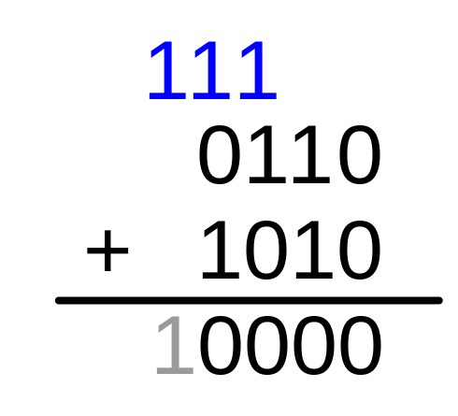
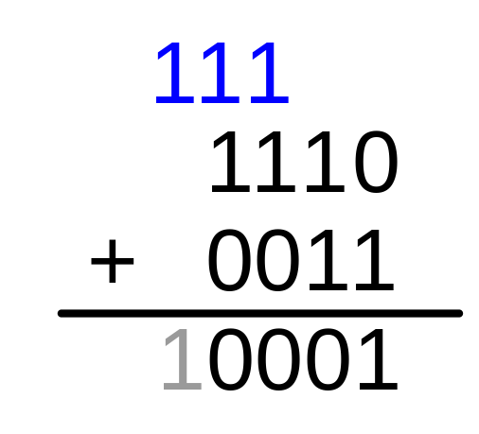
Two’s Complement Addition
Add 6 + (-6) using two’s complement numbers
Add -2 + 3 using two’s complement numbers
Copyright © 2007 Elsevier
1-<<number>>

Slide 35
Increasing Bit Width
A value can be extended from N bits to M bits (where M > N) by using:
  Sign-extension
  Zero-extension
Copyright © 2007 Elsevier
1-<<number>>

Slide 36
Sign-Extension (부호 확장)
Sign bit is copied into most significant bits.
Number value remains the same.
Example 1:
  4-bit representation of 3 = 0011
  8-bit sign-extended value: 00000011
Example 2:
  4-bit representation of -5 = 1011
  8-bit sign-extended value: 11111011
Copyright © 2007 Elsevier
1-<<number>>

Slide 37
Zero-Extension
Zeros are copied into most significant bits.
Number value may change.
Example 1:
  4-bit value = 0011
  8-bit zero-extended value: 00000011
Example 2:
  4-bit value = 1011
  8-bit zero-extended value: 00001011
Copyright © 2007 Elsevier
1-<<number>>

Slide 38
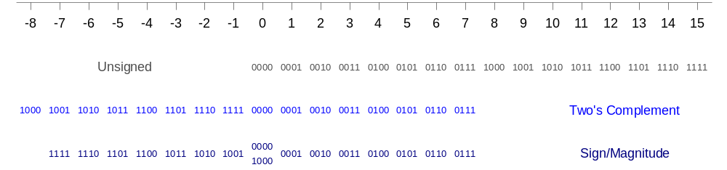
Number System Comparison
Number System | Range
Unsigned | [0, 2^{N}-1]
Sign/Magnitude | [-(2^{N-1}-1), 2^{N-1}-1]
Two’s Complement | [-2^{N-1}, 2^{N-1}-1]
For example, 4-bit representation:
Copyright © 2007 Elsevier
1-<<number>>

Slide 39
Logic Gates
Perform logic functions: inversion (NOT), AND, OR, NAND, NOR, etc.
Single-input:
  NOT gate, buffer
Two-input:
  AND, OR, XOR, NAND, NOR, XNOR
Multiple-input
Copyright © 2007 Elsevier
1-<<number>>

Slide 40
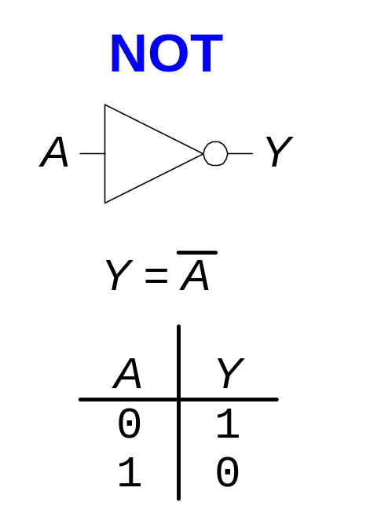

Single-Input Logic Gates
Copyright © 2007 Elsevier
1-<<number>>

Slide 41
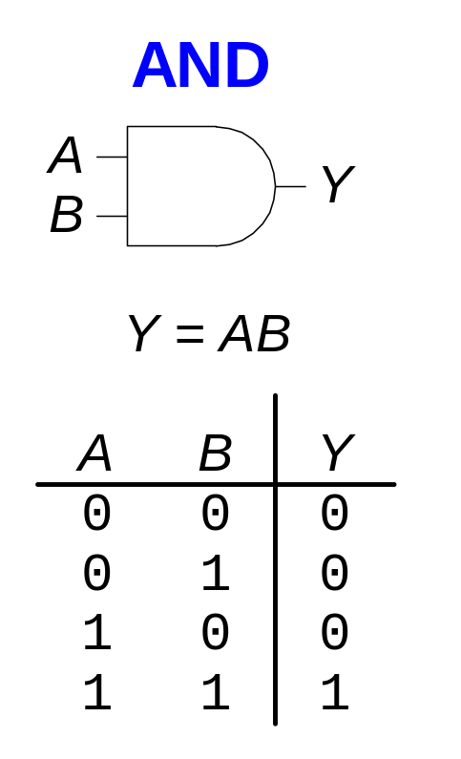
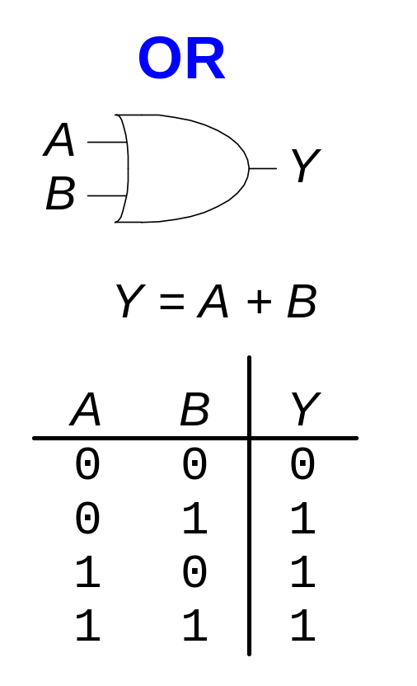
Two-Input Logic Gates
Copyright © 2007 Elsevier
1-<<number>>

Slide 42
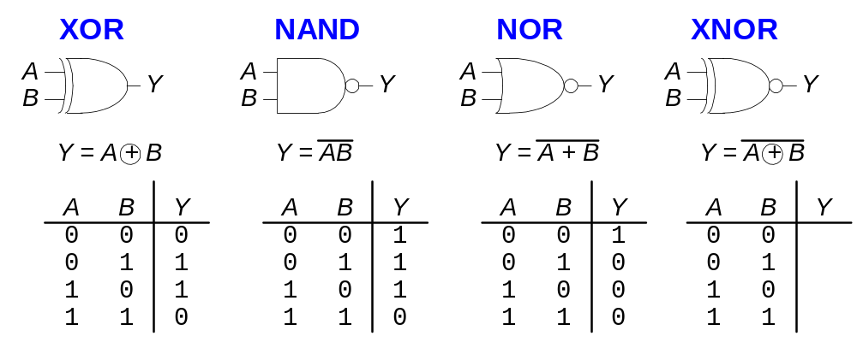
More Two-Input Logic Gates
Copyright © 2007 Elsevier
1-<<number>>

Slide 43
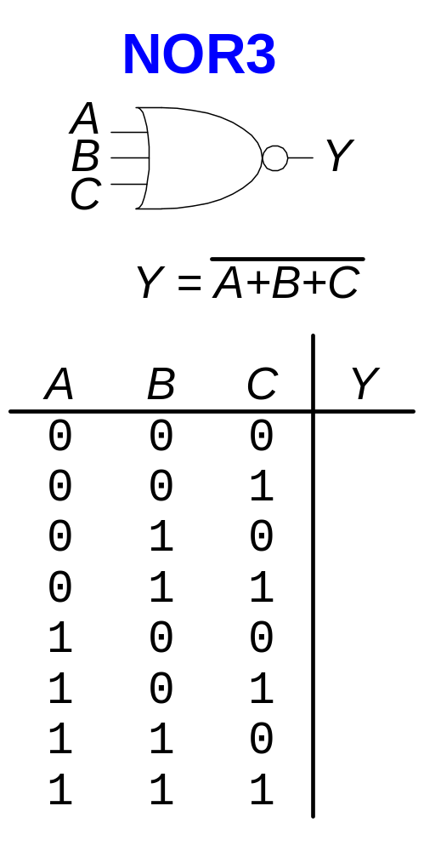
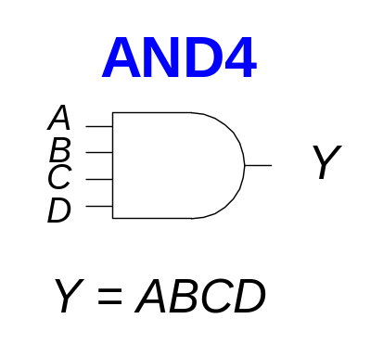
Multiple-Input Logic Gates
Copyright © 2007 Elsevier
1-<<number>>

Slide 44
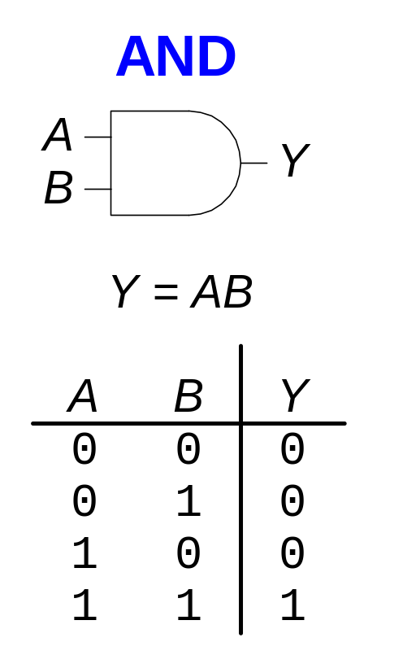
How do We Build Logic Gates?
Transistors!
Copyright © 2007 Elsevier
1-<<number>>

Slide 45
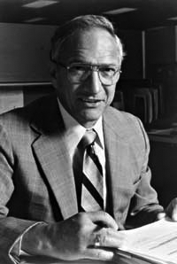
Robert Noyce, 1927 - 1990
Nicknamed “Mayor of Silicon Valley”
Cofounded Fairchild Semiconductor in 1957
Cofounded Intel in 1968
Co-invented the integrated circuit
Copyright © 2007 Elsevier
1-<<number>>

Slide 46
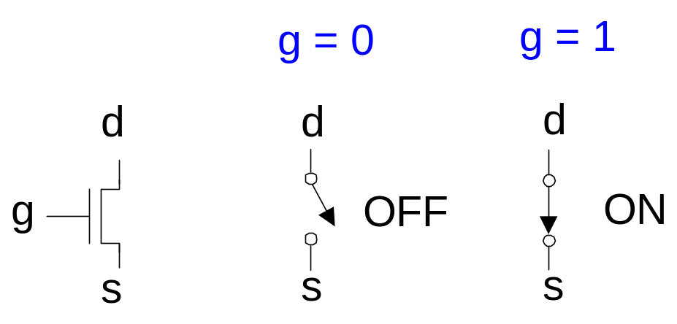
Transistor Basics (트랜지스터의 기초)
Transistor is a three-ported voltage-controlled switch
  Two of the ports are connected depending on the voltage on the third port
  For example, in the switch below the two terminals (d and s) are connected (ON) only when the third terminal (g) is 1
Copyright © 2007 Elsevier
1-<<number>>

Slide 47
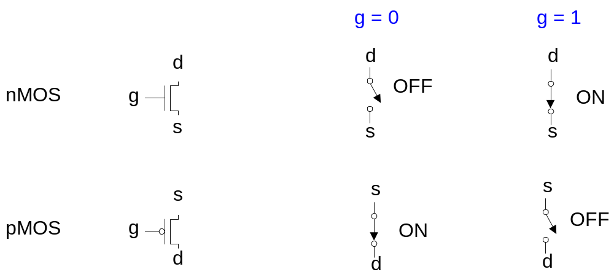
Transistor Function (트랜지스터의 기능)
Copyright © 2007 Elsevier
1-<<number>>

Slide 48

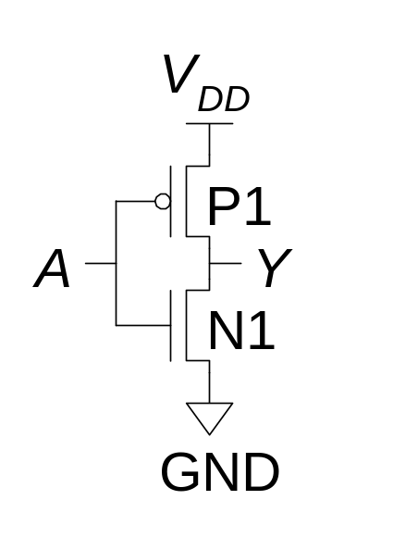
CMOS Gates: NOT Gate
A | P1 | N1 | Y
0 | ON | OFF | 1
1 | OFF | ON | 0
Copyright © 2007 Elsevier
1-<<number>>

Slide 49
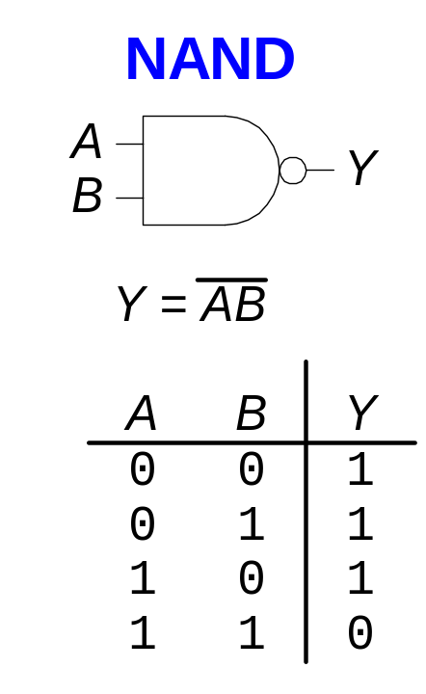
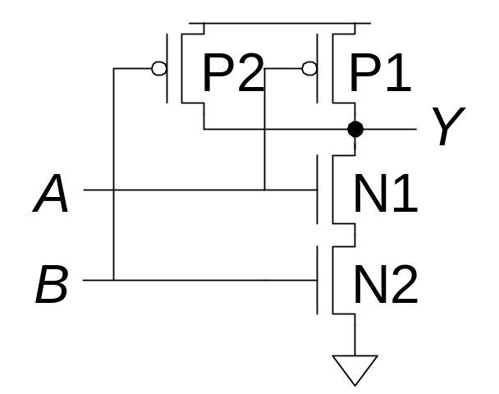
CMOS Gates: NAND Gate
A | B | P1 | P2 | N1 | N2 | Y
0 | 0 | ON | ON | OFF | OFF | 1
0 | 1 | ON | OFF | OFF | ON | 1
1 | 0 | OFF | ON | ON | OFF | 1
1 | 1 | OFF | OFF | ON | ON | 0
Copyright © 2007 Elsevier
1-<<number>>

Slide 50
NOR Gate
How do you build a three-input NAND gate?
Copyright © 2007 Elsevier
1-<<number>>

Slide 51
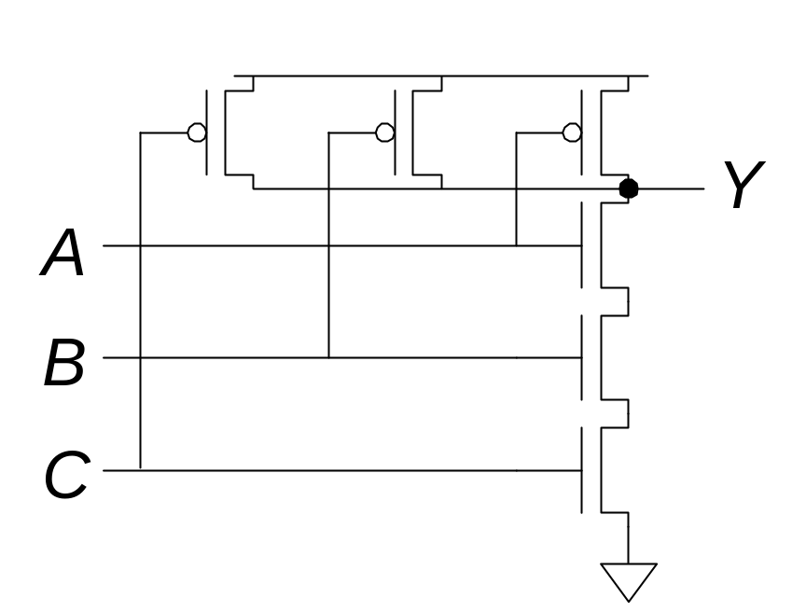
NOR Gate
Three-input NAND gate
Copyright © 2007 Elsevier
1-<<number>>

Slide 52
Other CMOS Gates
How do you build a two-input AND gate?
Copyright © 2007 Elsevier
1-<<number>>

Slide 53
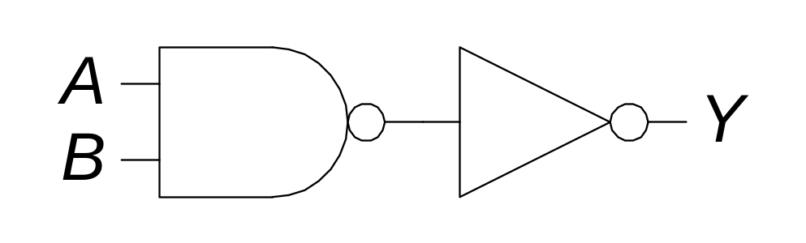
Other CMOS Gates
Two-input AND gate
Copyright © 2007 Elsevier
1-<<number>>

Slide 54
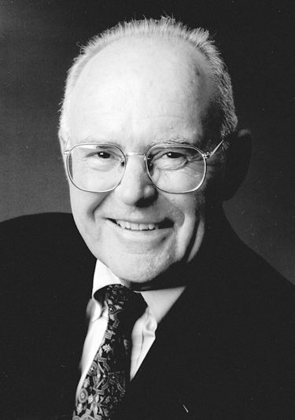
Gordon Moore (고든 무어), 1929 -
Cofounded Intel in 1968 with Robert Noyce.
Moore’s Law: the number of transistors on a computer chip doubles every year (observed in 1965)
Since 1975, transistor counts have doubled every two years.
http://en.wikipedia.org/wiki/Transistor_count
1-<<number>>

Slide 55
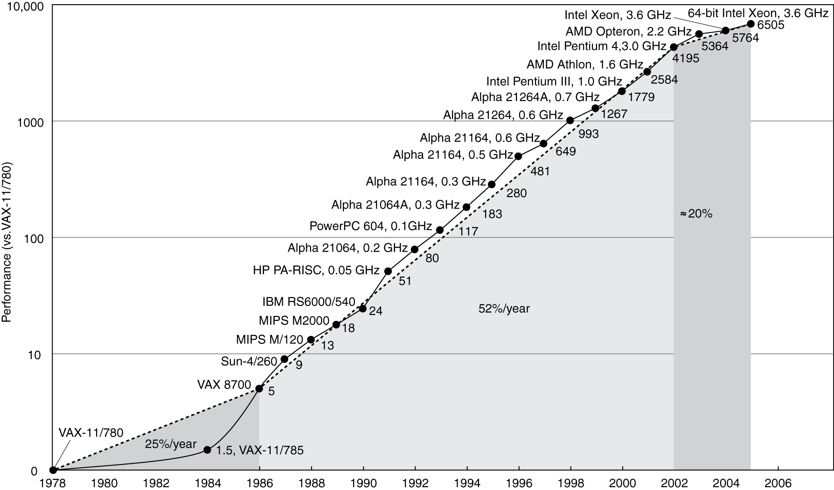
Uniprocessor Performance
Constrained by power, instruction-level parallelism, memory latency
Copyright © 2007 Elsevier
6-<<number>>

Slide 56
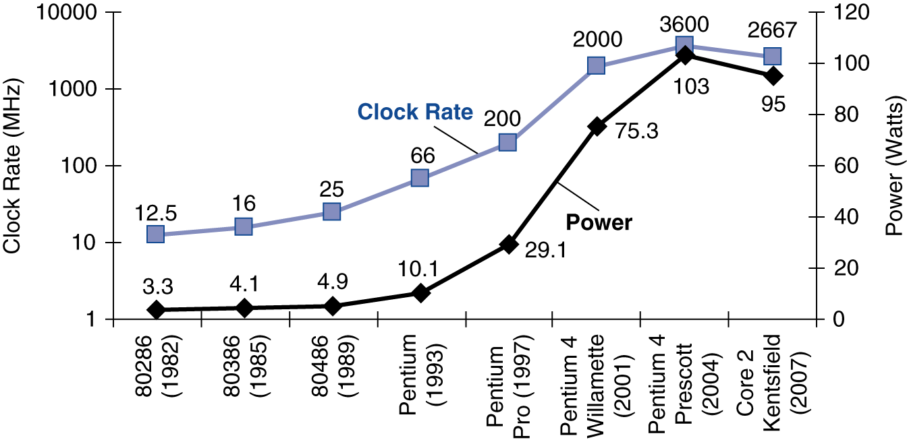
Power Consumption (전력 소모)
Energy consumption per unit time
  단위시간당 에너지 소모
Two types of power consumption:
  Dynamic power consumption (동적 전력 소모)
  Static power consumption (정적 전력 소모)
Copyright © 2007 Elsevier
1-<<number>>

Slide 57
Dynamic Power Consumption
Power to charge transistor gate capacitances
The energy required to charge a capacitance, C, to V_{DD} is CV_{DD}²
If the circuit is running at frequency f, and all transistors switch (from 1 to 0 or vice versa) at that frequency, the capacitor is charged f/2 times per second (discharging from 1 to 0 is free).
Thus, the total dynamic power consumption is:
P_{dynamic} = ½CV_{DD}²f
Copyright © 2007 Elsevier
1-<<number>>

Slide 58
Static Power Consumption
Power consumed when no gates are switching
It is caused by the quiescent supply current, I_{DD}, also called the leakage current
Thus, the total static power consumption is:
P_{static} = I_{DD}V_{DD}
Copyright © 2007 Elsevier
1-<<number>>

Slide 59
Power Consumption Example
V_{DD} = 1.2 V
C = 20 nF (나노 패럿)
f = 1 GHz
I_{DD} = 20 mA (밀리 암페어)
P = ½CV_{DD}²f + I_{DD}V_{DD}
= ½(20 nF)(1.2 V)²(1 GHz) +
(20 mA)(1.2 V)
= 14.4 W
Copyright © 2007 Elsevier
1-<<number>>

Slide 60
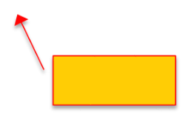
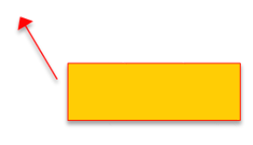
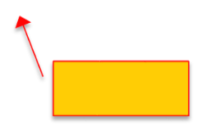
Power Trends
In CMOS IC technology
×?
5V → 1V
×1000
Copyright © 2007 Elsevier
6-<<number>>

Slide 61

Reducing Power
Suppose a new CPU has
  85% of capacitive load of old CPU
  15% voltage and 15% frequency reduction
The power wall (전력 소모의 벽)
  We can’t reduce voltage further
  We can’t remove more heat
How else can we improve performance?
Copyright © 2007 Elsevier
6-<<number>>

Slide 62
Multiprocessors
Multicore microprocessors (멀티코어)
  More than one processor per chip
Requires explicitly parallel programming
  Compare with instruction level parallelism
    Hardware executes multiple instructions at once
    Hidden from the programmer
  Hard to do
    Programming for performance
    Load balancing
    Optimizing communication and synchronization
Copyright © 2007 Elsevier
6-<<number>>

